Slide 1

Number Series
Placement Preparation
Aptitude & Reasoning
Prof. Krunal D. Vyas
Computer Engineering Department
krunal.vyas@darshan.ac.in
9601901005

Slide 2
1. Pure series
In this type of series, the number itself obeys certain order so that the character of the series can be found out.
For e.g. Even number, Odd number, Prime number, Perfect square, Perfect cube, etc..
Example-1: 2, 4, 6, 8, 10, ?
Solution-1: As per even series pattern, answer is 12.
Example-2: 2, 3, 5, 7, 11, 13, ?
Solution-2: As per prime series pattern, answer is 17.
Example-3: 6859, 5832, 4913, 4096, 3375, ?
Solution-3: As per perfect cube series pattern, answer is 2744.

Slide 3
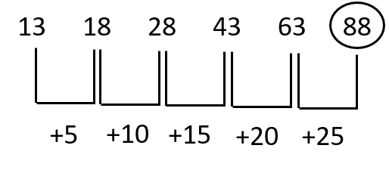
2. Difference series:
Under this category, the change in order for the differences between each consecutive number of the series is found out.
Example: 13, 18, 28, 43, 63, ?
Solution:

Slide 4
3. Geometric series:
Under this category, each successive number is obtained by multiplying (or dividing) the previous number with a fixed number.
Example: 5, 35, 245, 1715
Solution: Here previous number is multiplied by 7, hence answer is 12005.

Slide 5
4. Mixed series:
Under this category, the number obeying various orders of two or more different type of series are arranged alternately in a single number of series.
Example: 7, 4, 5, 9, 20, ?
Solution: Here, second number is smaller than first one but from second number onwards, the series is in ascending order. So, there should be multiplication with fraction number or subtraction along with smaller multiplication.
• 7 x 0.5 + 0.5 = 4, 4 x 1 + 1 = 5, 5 x 1.5 + 1.5 = 9, 9 x 2 + 2 = 20, 20 x 2.5 + 2.5 = 52.5
• Hence, answer will be 52.5

Slide 6
5. Merged series:
Under this category, usually two series are given with alternate position like one series is given for each odd place and second series is given for each even place.
Example: 5, 25, 7, ? , 9, 19
Solution: One series is 5, 7, 9 (+2)
Second series is 25, ? , 19 (-3)
Hence, answer will be 25 - 3 = 22

Slide 7
Exercise
Ex-1: 100, 50, 52, 26, 28, ?
Ex-2: 25, 34, 30, 39, 35, ?
Ex-3: 32, ?, 92, 134, 184
Ex-4: 5, 12, 39, 160, 805, ?
Ex-5: 16, 8, 12, 30, ? , 472.5

Slide 8
Ans = 14
Ans = 44
Ans = 58
Ans = 4836
Ans = 105

